Slide 1

www.rssimmons.com
info@rssimmons.com

Slide 2
What SimmScope SOI is
SOI = Semi-automatic Optical Inspection for PCBAs.
SOI is a tool for the Manual Inspector to make inspections faster, more accurate, and less fatiguing.
SOI is self-documenting for traceability.
SOI is a photo documentation tool.
SOI has optional side viewing capability.
SOI bridges the gap between manual inspections and fully-automatic AOI machines.

Slide 3
What SimmScope SOI is Not
SOI is not AOI.
SOI does not make pass/fail calls automatically. The human inspector makes all the calls.
SOI does not require a high level (and highly paid) programmer.
SOI does not take hours to program, it takes minutes.

Slide 4
What SimmScope SOI Does
Automatically moves a live camera to the inspection point with the correct height, viewing angle, and lighting, and zooms to the region of interest.
Displays a golden board image for visual comparison.
For difficult inspection points, the lighting and view can be adjusted using the graphical interface.
The images are automatically captured and can be stored as part of a post inspection report.

Slide 5
What are the Many Uses
High Reliability Inspection where a human is required to have “eyes on” the PCB.
Low Volume 100% Inspection
Assembly Line Auditing
First Article Inspection
Solder Joint Inspection
Thru-hole Component Inspection
Cleanliness Inspection
Conformal Coating Inspection
Photo Documentation of Any Visual Feature

Slide 6
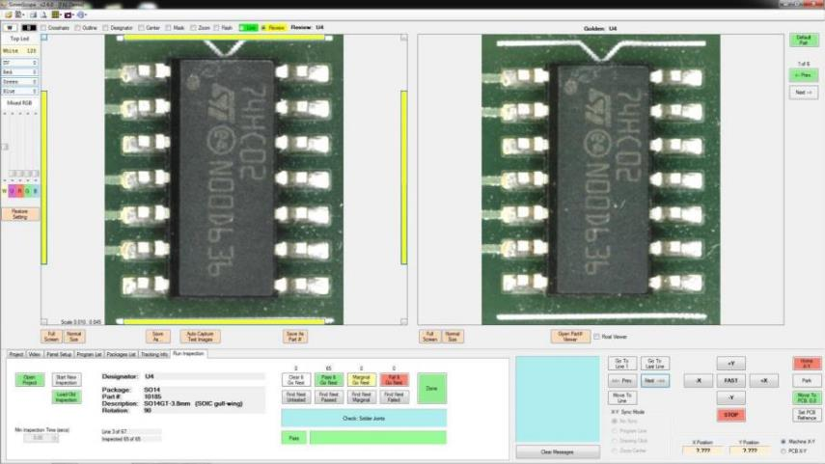
The Main Interface
The inspector compares the Live image to the Golden image and either passes or fails the inspection point.

Slide 7
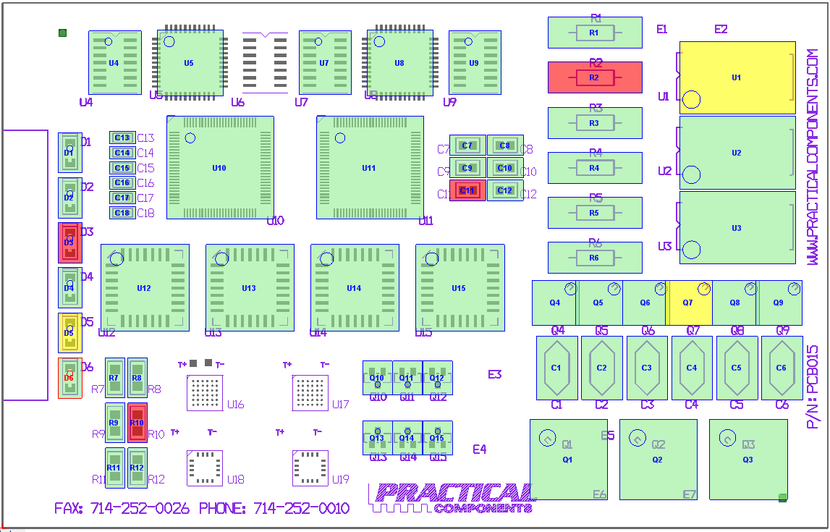
Inspection by Component
The system displays an interactive graphic of the entire inspection. Completed inspection points are color coded.

Slide 8
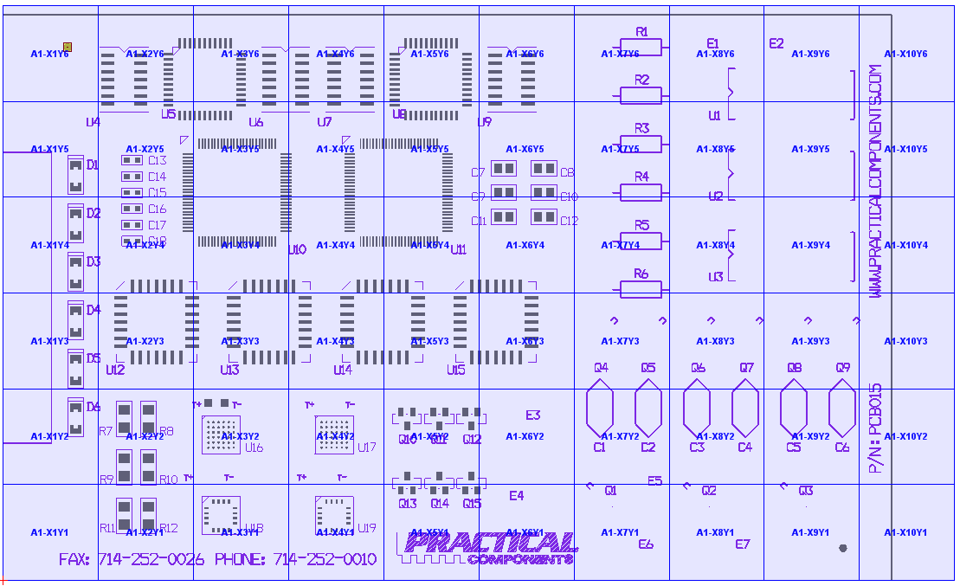
Inspection by Matrix
In addition to single component inspection, the system can be programmed to inspect regions of interest.

Slide 9
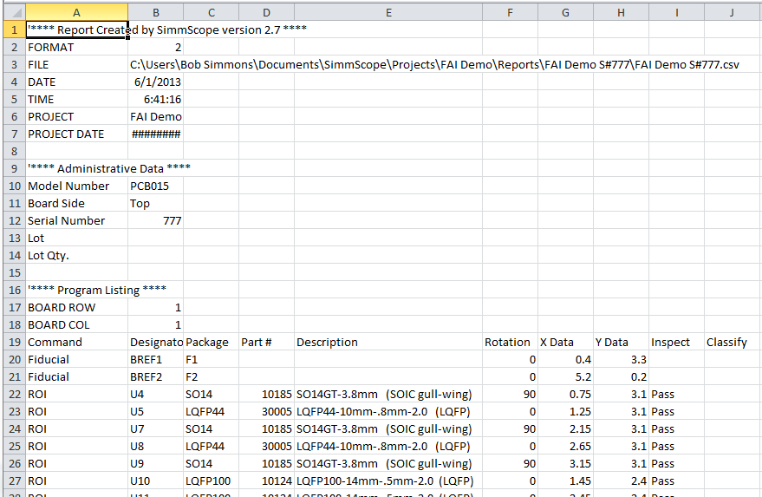
Spread Sheet Report
An Excel compatible report of every inspection point can be generated for each inspection.

Slide 10
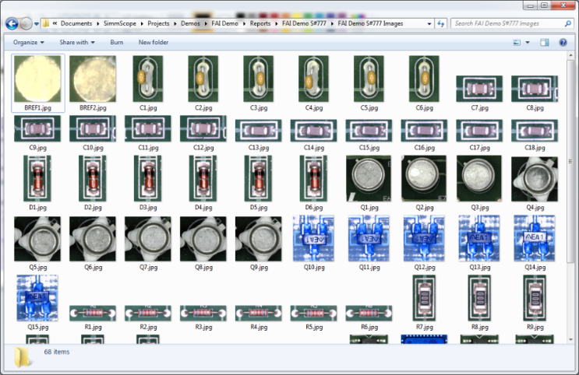
Automatic Photo Archiving
A captured image for every inspection point can be saved as part of the report for traceability.

Slide 11
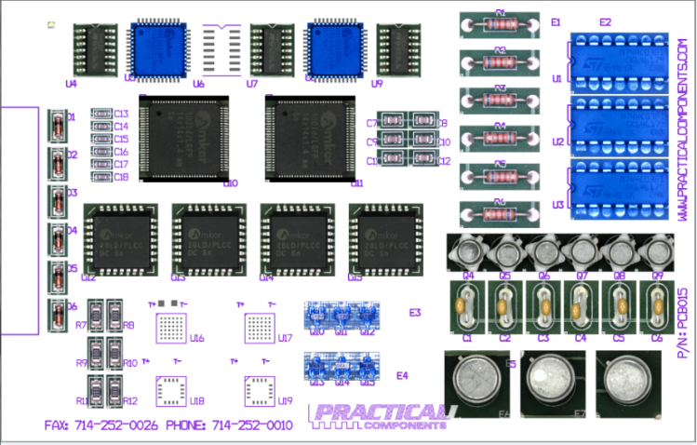
Hybrid Image Creation
As part of the reporting options, a tiled image of the inspection points overlaid onto the Gerber as the background can generated.

Slide 12
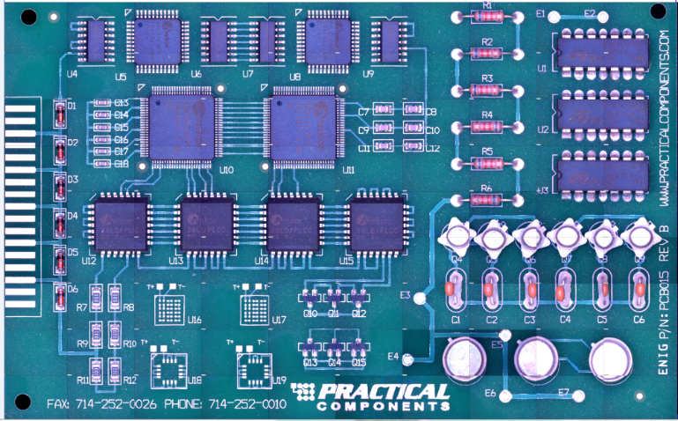
Image Tiling
If using matrix mode, an entire tiled image of the board can be generated as part of the report.

Slide 13
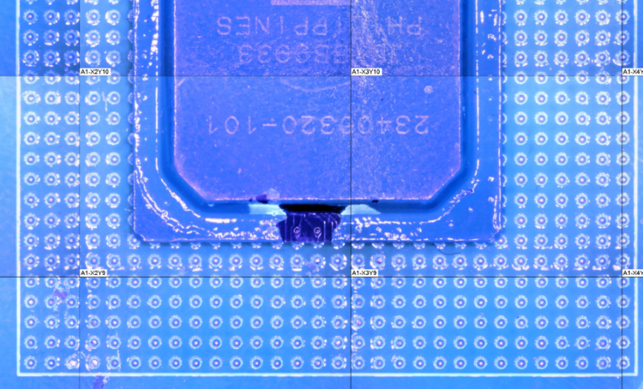
UV Image Tiling
The system can also be used with the optional UV lighting for conformal coating inspection.

Slide 14
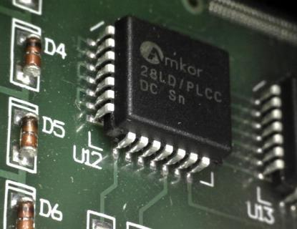
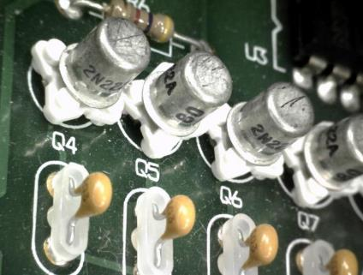
Optional Side View
The Side View option adds oblique viewing in 8 programmable positions around each component.

Slide 15
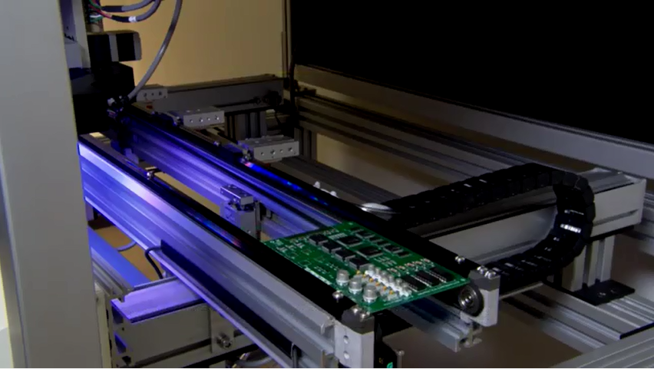
Other Options
Other options include floor standing, SMEMA conveyor feed, and programmable conveyor width control.

Slide 16
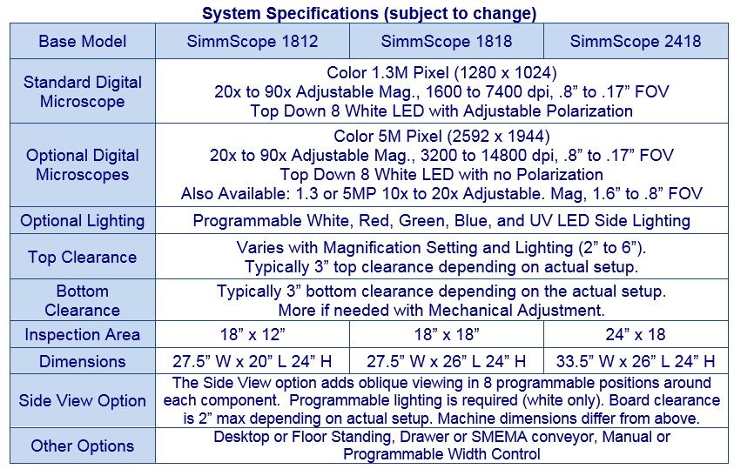
System Specifications

Slide 17

Some Valued Customers

Slide 18

www.rssimmons.com
info@rssimmons.com

